Slide 1
Summary: In my humble opinion, riding a bike trainer is mind numbing.
Playing a flight simulator (without warping time) is equally mind numbing.
In combination, the lead to a palatable activity for me.

Slide 2

Details: Playing a flight simulator with a joystick with a throttle axis is better than
just using a keyboard and mouse.
Throttle axis

Slide 3

Details: What if a bike on a trainer could be used to control the throttle axis?
Bike on trainer; sweat guards in place.
Sweat guards prevent corrosion.

Slide 4

Details: How could could the speed sensor on the rear wheel be used?
Speed sensor
Required

Slide 5
Details: When the wheel is spinning, the speed sensor transmits, with blue
tooth low energy, information on the total number of spins and angular
speed of the last spin.
Here is an 8 byte transmission (that occurs every second unless the
speed sensor stops spinning for ??? minutes) [also known as
rawValue]:
1 ,5 ,16 ,0 ,0 ,182 ,82 ,0
The total number of rotations is the sum of
5 * 256^0
16 * 256^1
0 * 256^2
0 * 256^3
The “last event” occurred at
182 * 256^0
82 * 256^1

Slide 6

Details: Capturing this stream of bytes filled the programming space of an Uno
WiFi Rev2 Arduino
A second Arduino is required.
The BLE signal from the speed sensor must be read by sensor no
more than arms length away.

Slide 7
What is an Arduino?
From “opensource.com”:
In a nutshell, an Arduino is an open hardware development board that can be used by tinkerers, hobbyists, and makers to design and build devices that interact with the real world.

Slide 8


Details: These 8 bytes of information are transmitted via the wire interface
(using the ground, SCL [serial clock], and SDA [serial data] pins) to an
Arduino Leonardo that can act as joystick.

Slide 9
Details: How does this stream of bits (rawValue) become a throttle axis
position?
$\begin{aligned}joystickThrottleValue=\frac{currentSpeed}{speedShouldBe}∗\left(maxThrottle−minThrottle\right)+minThrottle \\ speedShouldBe=−exp\left(\frac{−distanceTravelled}{speedGradient}\right)∗speedDelta+maxSpeed \\ distaceTravelled=\left(WheelRevsTemp∗wheelCirCM\right)∗\left(\frac{kilometer}{mile}\right)∗\left(\frac{mm}{m}\right)\left(\frac{m}{km}\right) \\ currentRotations=wheelRevsTemp={rawValue}_{1}+{rawValue}_{2}∗{256}^{1}+{rawValue}_{3}∗{256}^{2}+{rawValue}_{4}∗{256}^{3} \\ wheelCirCM=2096mm \\ speedDelta=13.8\frac{miles}{hour} \\ maxSpeed=25.5\frac{miles}{hour} \\ speedGradient=8.61miles \\ maxThrottle=32767bits \\ minThrottle=−32767bits \\ currentSpeed=\frac{approximateSpeed∗1024}{deltaWheelEvent} \\ approximateSpeed=\left(\frac{\left(currentRotations−previousRptations\right)∗wheelCirCM}{\left(1000\frac{mm}{m}∗1000\frac{m}{km}\right)}\right)∗\left(\frac{miles}{km}\right)∗\left(3600\frac{seconds}{hour}\right) \\ previousRotations={\left({rawValue}_{minusOne}\right)}_{1}+{\left({rawValue}_{minusOne}\right)}_{1}+{\left({rawValue}_{minusOne}\right)}_{2}∗{256}^{1}+{\left({rawValue}_{minusOne}\right)}_{3}∗{256}^{2}\end{aligned}$

Slide 10
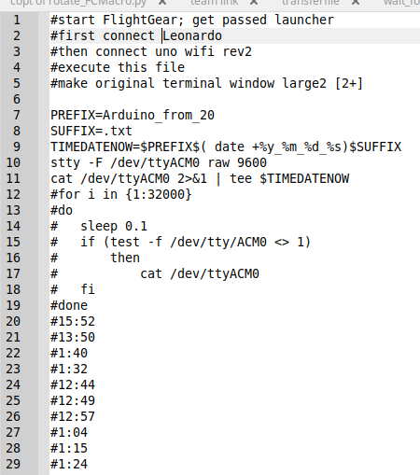
This is nerdy, and I am pretty sure the Arduinos are working even if their serial outputs are not visible, but, I like to know they are working (and how hard I am working the bike) while playing FlightGear.

Slide 11
How are SpeedGradient, SpeedDelta, and MaxSpeed defined?
I found something that worked for me….
If I had to do it today, starting from nothing, I would ride the trainer, ignoring the throttle setting in the flight simulator and record the serial output of the Leonardo Ardiuno.
That data I would get into the first column of a spreadsheet with top row blank.
B1 I would title “First ‘=’”
B2... would have the formula, “=find(“=”,A2)”
C1 I would title “Second ‘=’”
C2...would have the formula, “=find(“=”,b2+2)”
D1 I would title “space after second equal+2”
D2 …would have the formula, “=find(“ ”,c2+2)”

Slide 12
F1 I would title “’==’ location”
F2 ...
G1 I would title “space after ‘==’”
G2 ...
H1 I would title “distance (mi)”
H2 ...

Slide 13
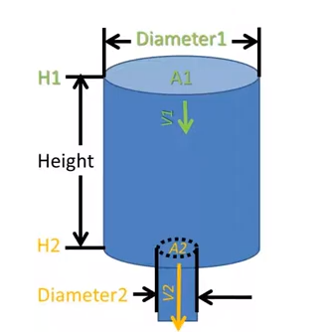
Details: Why use an exponential function?
Think of your effort on the bike trainer as a stream of water. Think of
your bike trainer as a tank for that water. That tank has a small hole at
the bottom. Water leaves that tank at a rate proportional to its water height. As time goes on, the tank will reach a constant level. That water (trainer temperature) represents the resistance of your trainer. As time passes, the resistance decreases and you pedal faster. This produces a differential (i.e. difficult) equation whose solution includes an exponential function.
https://www.youtube.com/watch?v=-1ARYph3mNA

Slide 14
Quiz:
An Arduino is?
A. Small lizard common indigenous to Northern Mexico
B. Hardware development circuit board
C. An alternative to salt-peter
D. Slang for a nerdy middle school student
The stream of data from a speed sensor is made up of how many bytes every second?
A. 8
B. 1
C. 64
D. 2
How many Arduinos did Todd use to transform a bike trainer into a joystick throttle axis?
A. 0
B. 1
C. 2
D. 16
What pins are used by the Arduino “Wire” library
A. SDA
B. SCL
C. Ground
D. All of the above

Slide 15
Quiz:
At most, how manty bytes of the speed sensors’ transmission are used by Todd’s Arduinos every second?
A. 64
B. 6
C. 7
D. 8
How many bytes comprise the “last event” evaluation?
A. 2
B. 4
C. 8
D. 16
Who determines when it is necessary to operate the bike’s shifters?
A. The end user decides.
B. The end user is given suggestions by the Arduino.
C. The Arduino wire library dictates this to the cyclist
D. The shifters operare through BLE

Slide 16
Quiz:
According to Todd, using a bike trainer is:
A. Mind-numbing
B. Exhausting
C. Critical for improving short-term strength
D. Furniture, similar to a couch
The units of “speed gradient”, if distance travelled is miles, are:
A. millimeters
B. miles per hour
C. miles
D. unit less
The exponential function used by Todd to determine what the cyclists’ speed should be is:
$\begin{aligned}A.speedShouldBe=exp\left(\frac{−distanceTravelled}{speedGradient}\right)∗speedDelta+maxSpeed \\ B.speedShouldBe=−exp\left(\frac{−distanceTravelled}{speedGradient}\right)∗speedDelta+maxSpeed \\ C.speedShouldBe=−exp\left(\frac{distanceTravelled}{speedGradient}\right)∗speedDelta+maxSpeed \\ D.speedShouldBe=exp\left(\frac{distanceTravelled}{speedGradient}\right)∗speedDelta+maxSpeed \\ \end{aligned}$

Slide 17
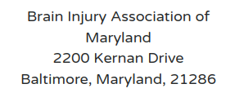
I am in debt to the Holy Spirit for gently encouraging me to move forward on this project.
If you are moved, please make a donation to:

Slide 18
Thing left to do:
add slides to show how to define speedDelta, maxSpeed, speedGradient
what is an Arduino?
make a quiz
make a box for Arduinos
order USB cables
email Bryan Pugh about presenting next year
offer CEUs to other PEs
oring for speed sensor

Slide 19
Subsequent slides can be ignored

Slide 20
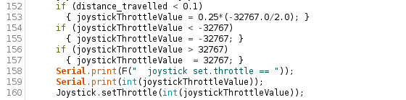
Details: How does speed on the trainer determine throttle axis position?
I set the throttle to by 25% of maximum for the initial 0.1 miles of
travel to allow for manuallly starting the engine
Also, the throttle position should be between -32676 and 32767

Slide 21

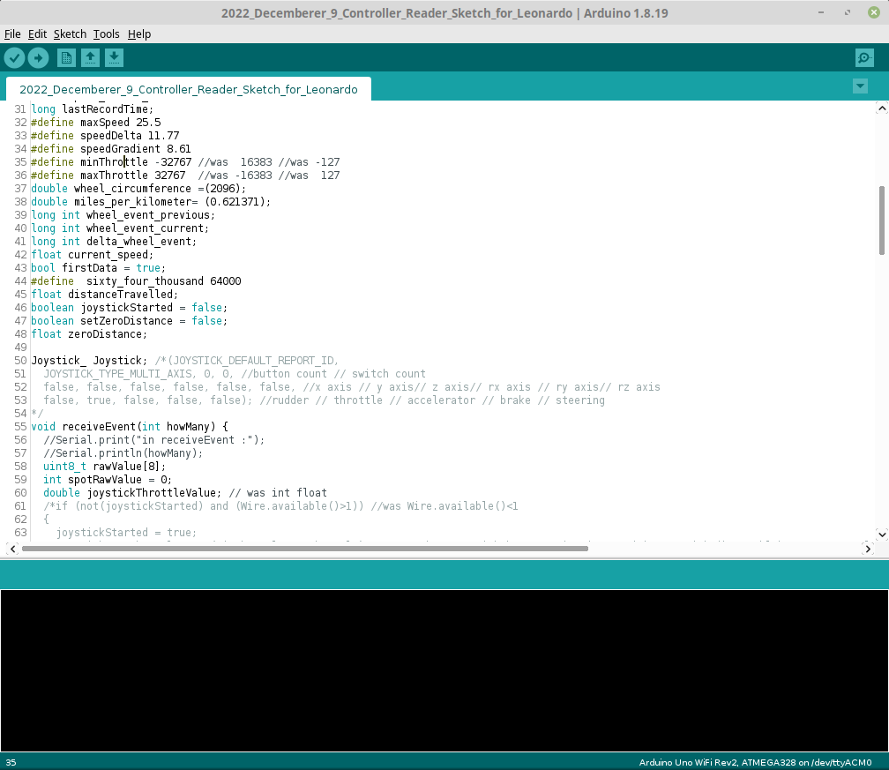
Details: How does speed on the trainer determine throttle axis position?
joystickThrottleValue is proportional to current_speed divided by
speed_should_be and then stretched for the minimum throttle
value to the maximum throttle value

Slide 22
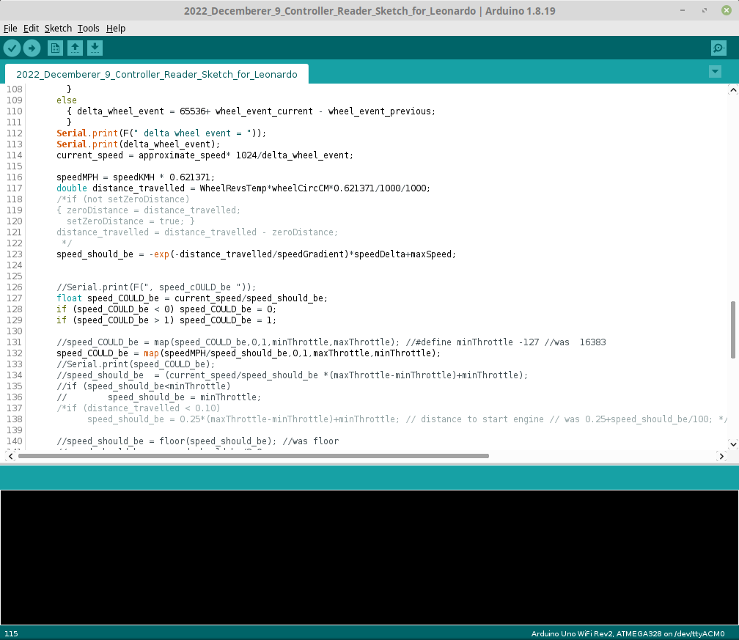
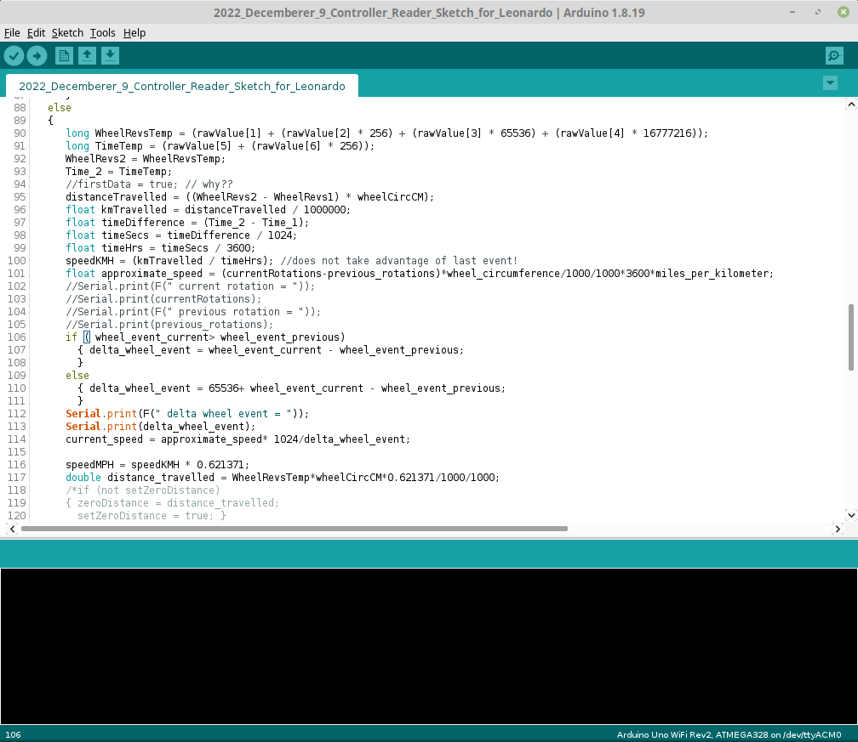
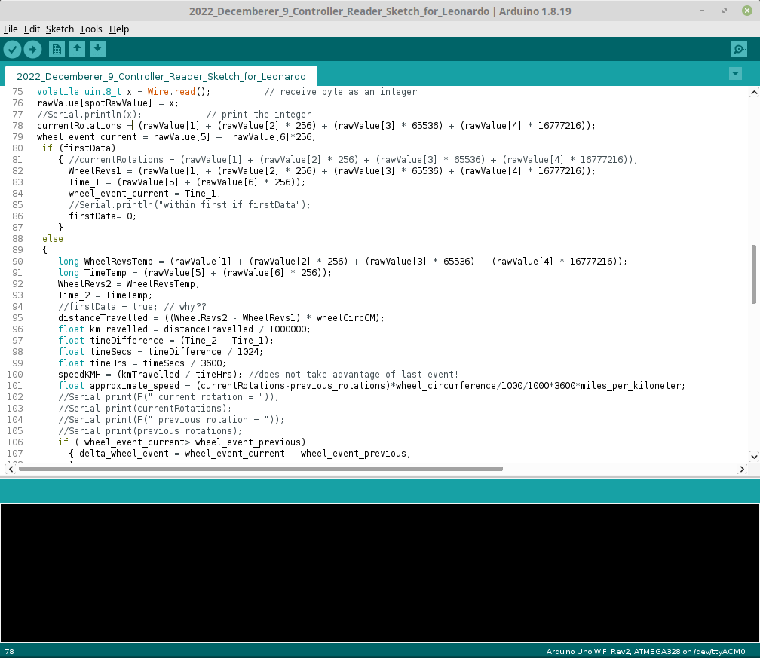
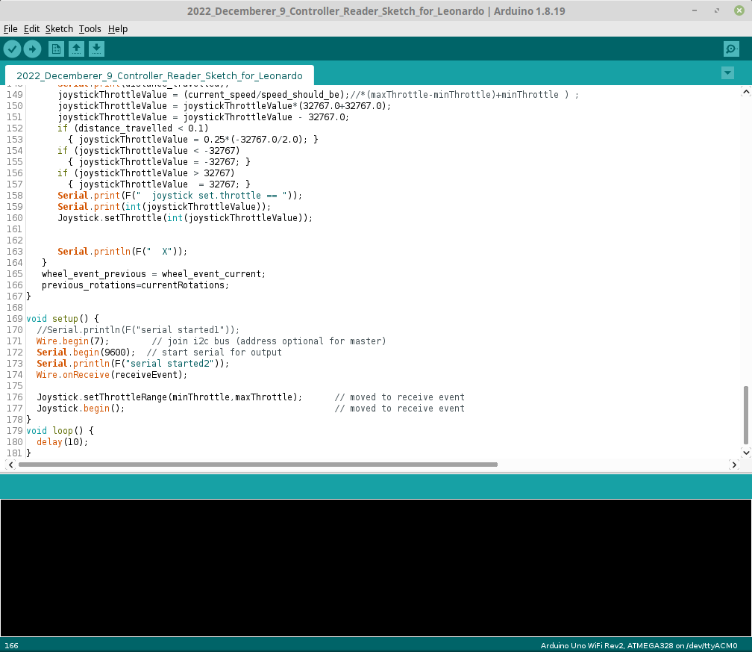
Details: How is current_speed determined
Details: How approximate speed determined
Details: How is current rotations determined
Details: Where is previous rotations set

Slide 23
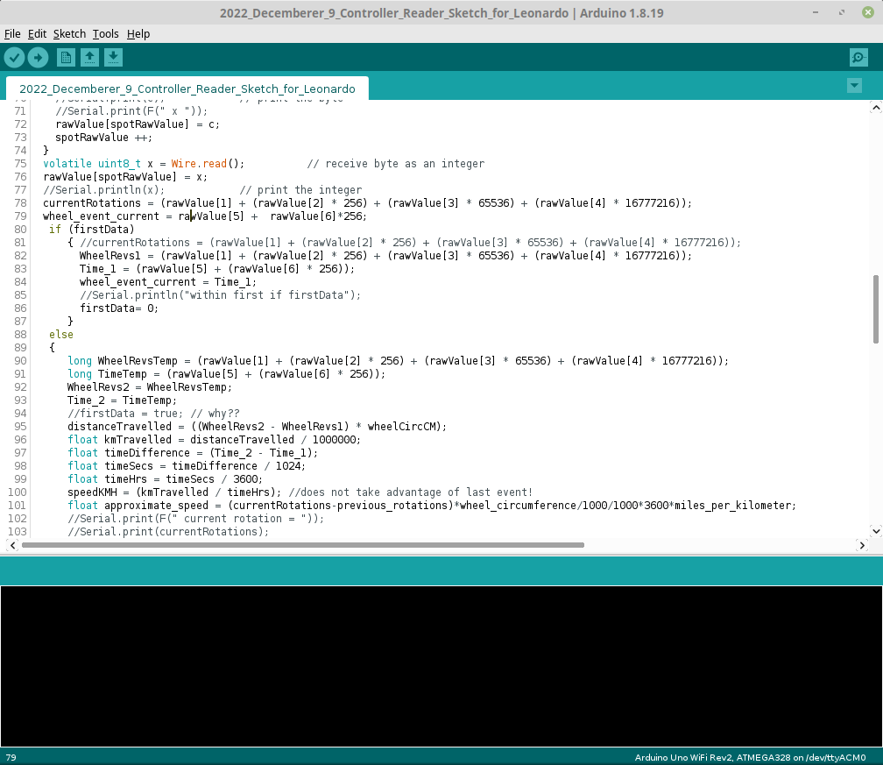
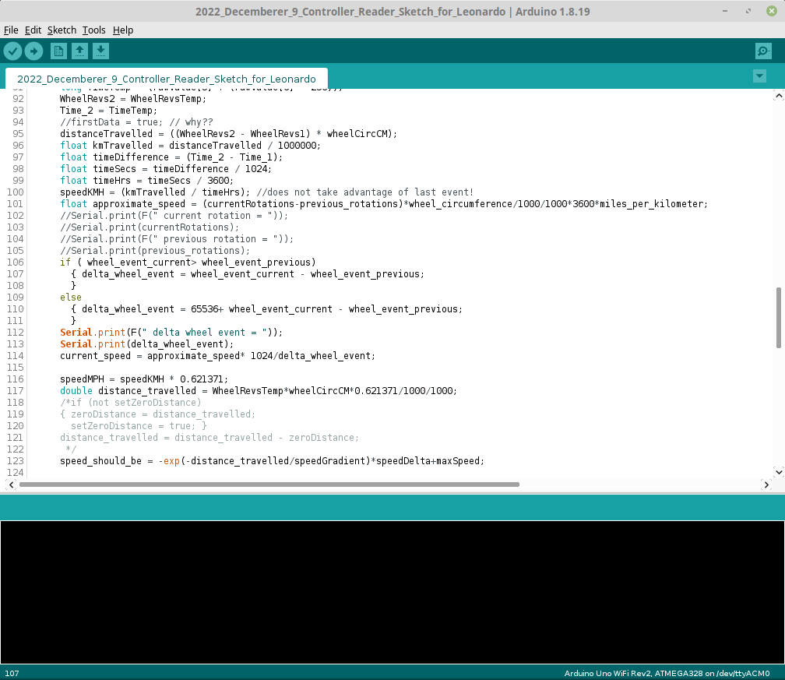
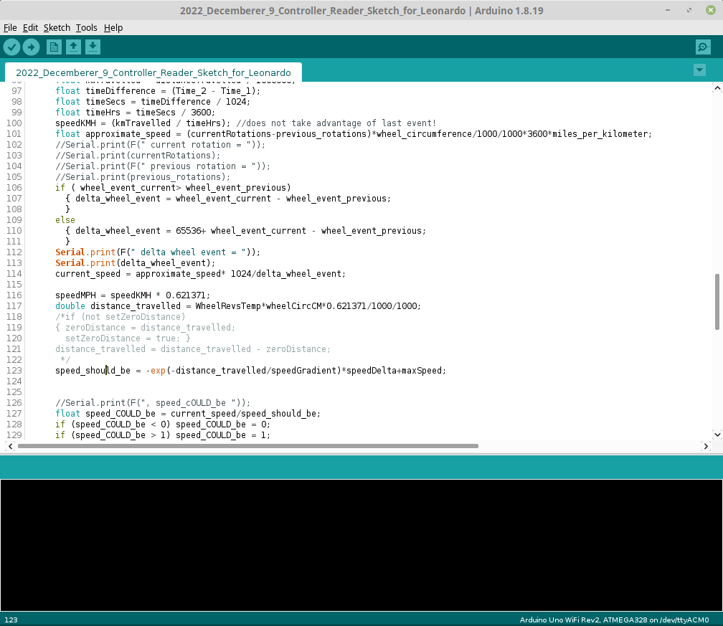
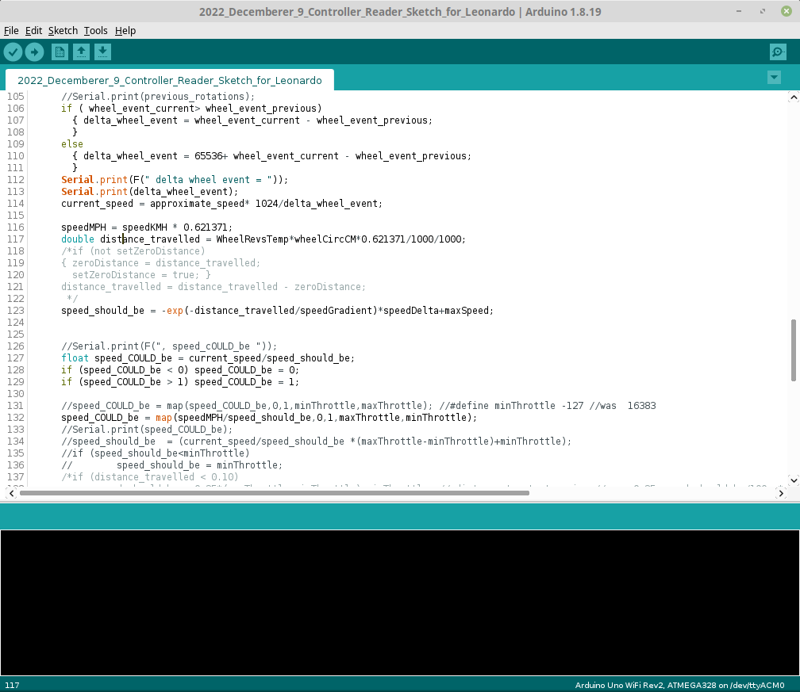
Details: Where delta_wheel_event set
Details: Where is speed_should_be determined?
Details: Where is distance_travelled set

Slide 24
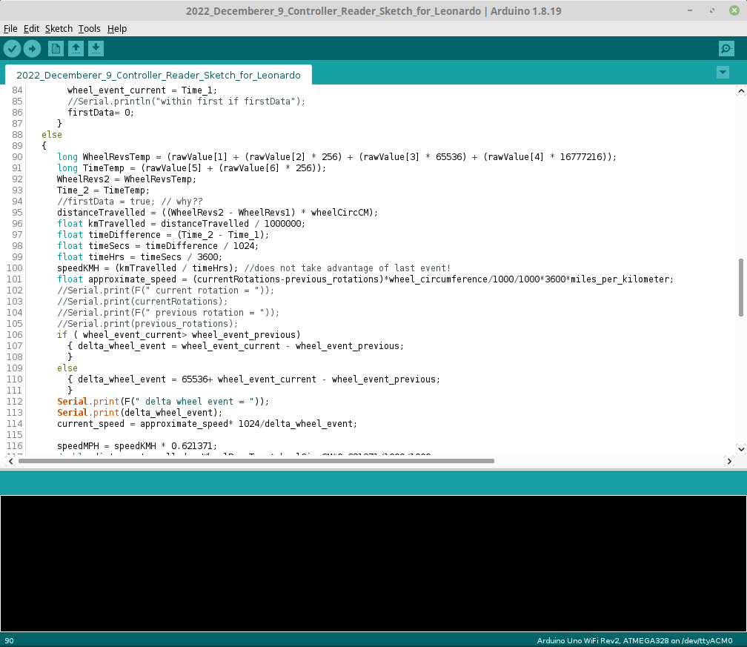
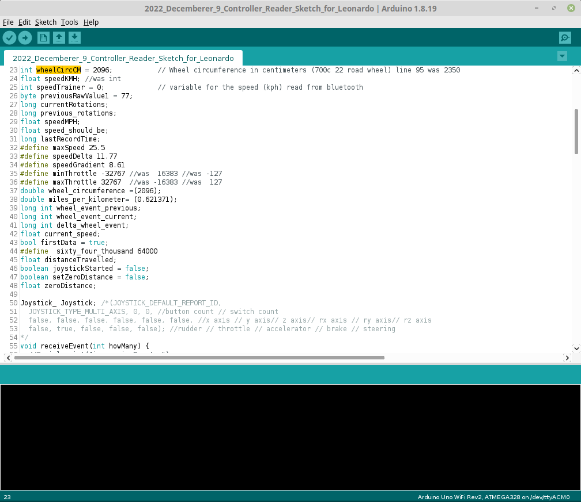
Details: WheelRevsTemp set
Details: What about WheelCcm?
wheel circumference in mm; you wheel might be different. Do a google search for { “wheel circumference” and “2096” }

Slide 25
Details: maxSpeed is the fastest the cyclist could ever pedal on a bike trainer. (I
found this using an app on my Android cell phone) [mile per
hour]
speedDelta is the difference between my initial speed and maxSpeed. [mile
per hour]
13.8 mph was calculated: [25.5mph –11.7 mph == 13.8 mph.
SpeedGradient was determined using a least square fit to the previously explained exponential function from data amasses.

Slide 28
Disorganized, but how distance and speed are calculated are shown in detail...

Slide 29
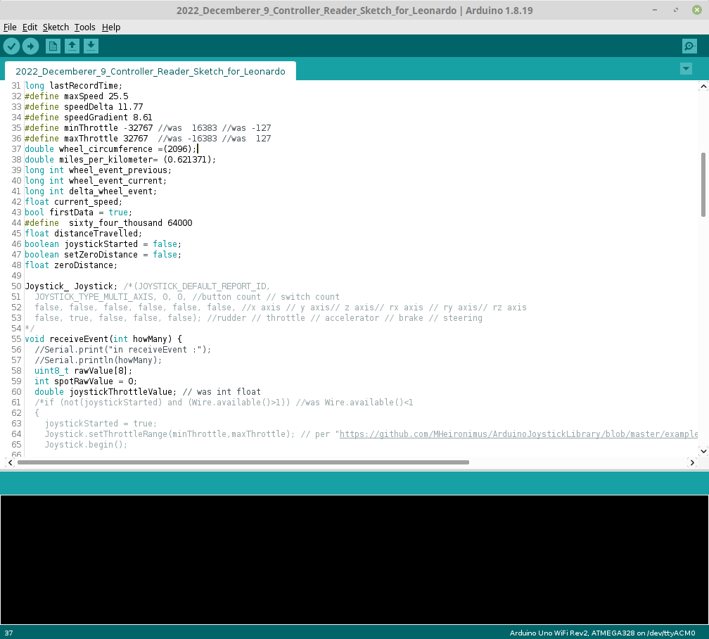
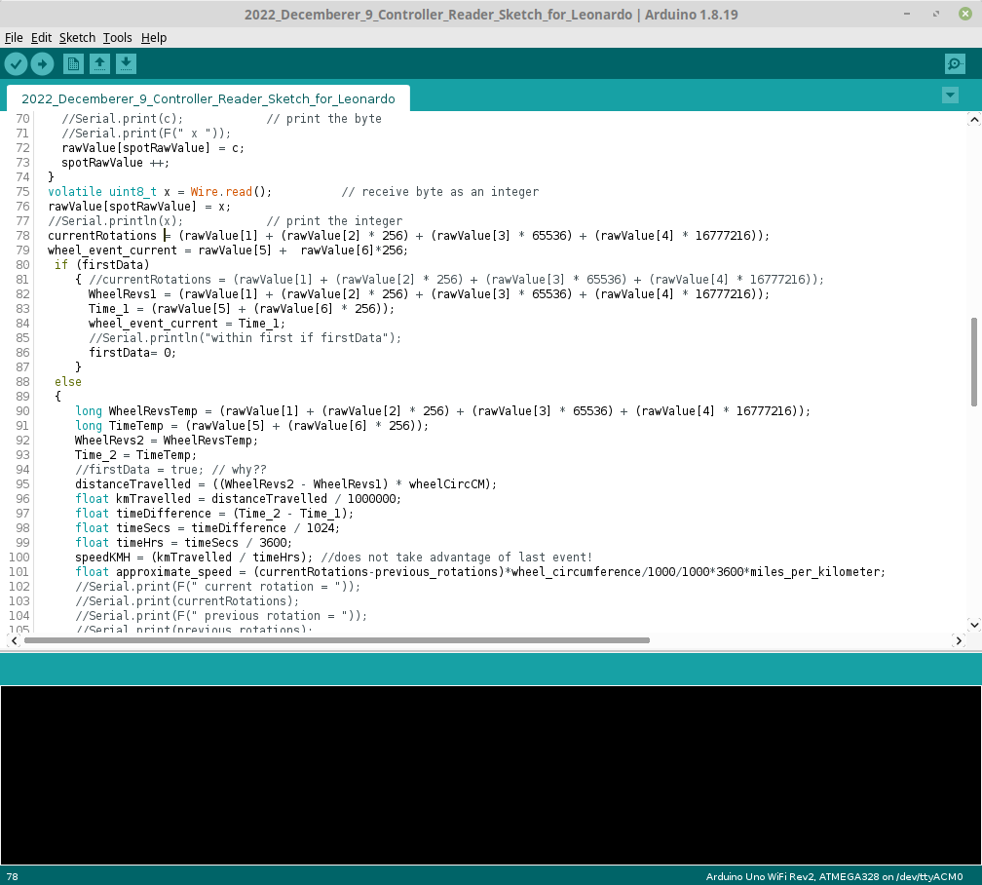
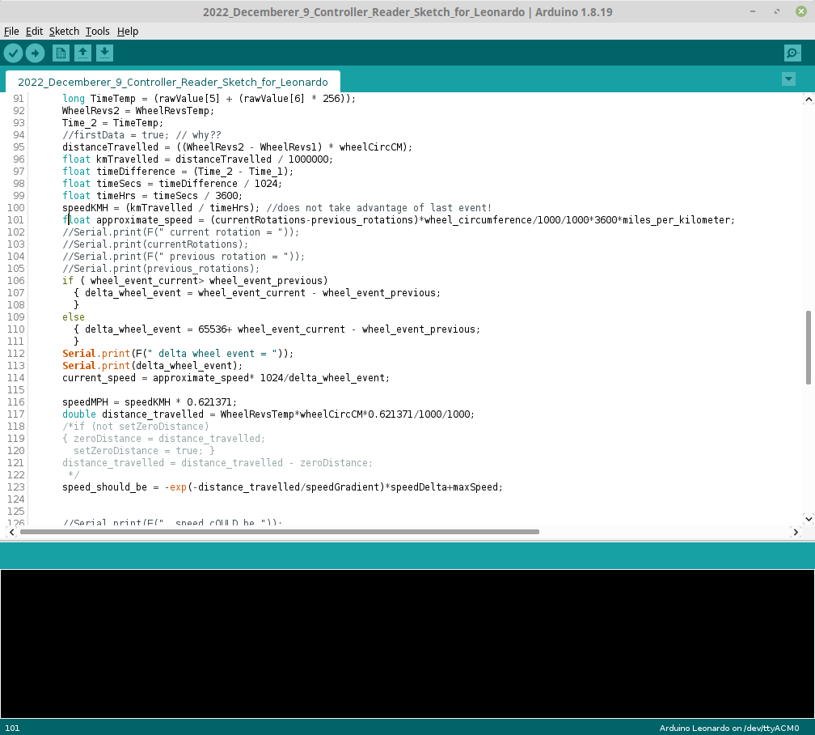
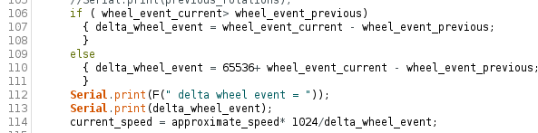
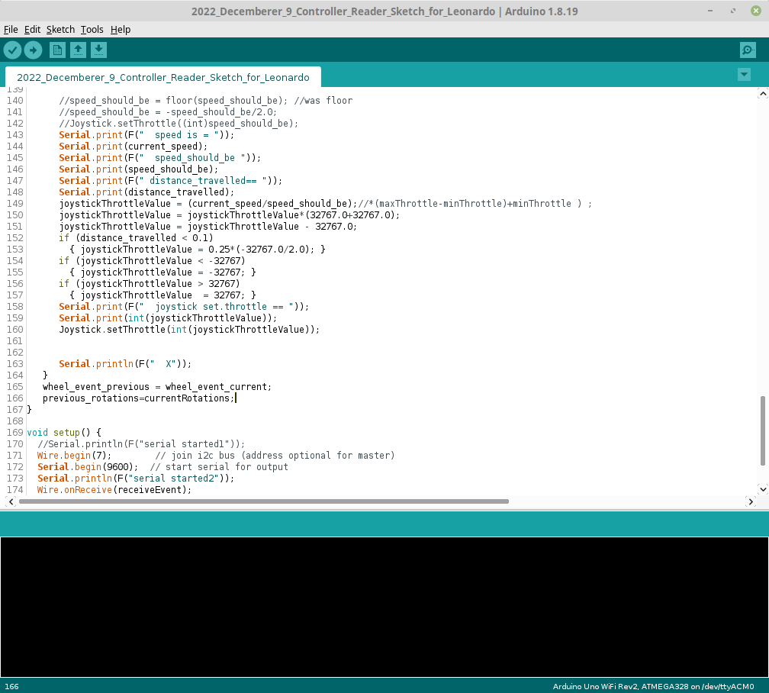
Details: Frankly, I lack the mental gift to translate the last event time and total
rotations into speed. I copied code I found on the internet.
Wheel circumference is the circumference of your rear wheel in millimeters.

Slide 30
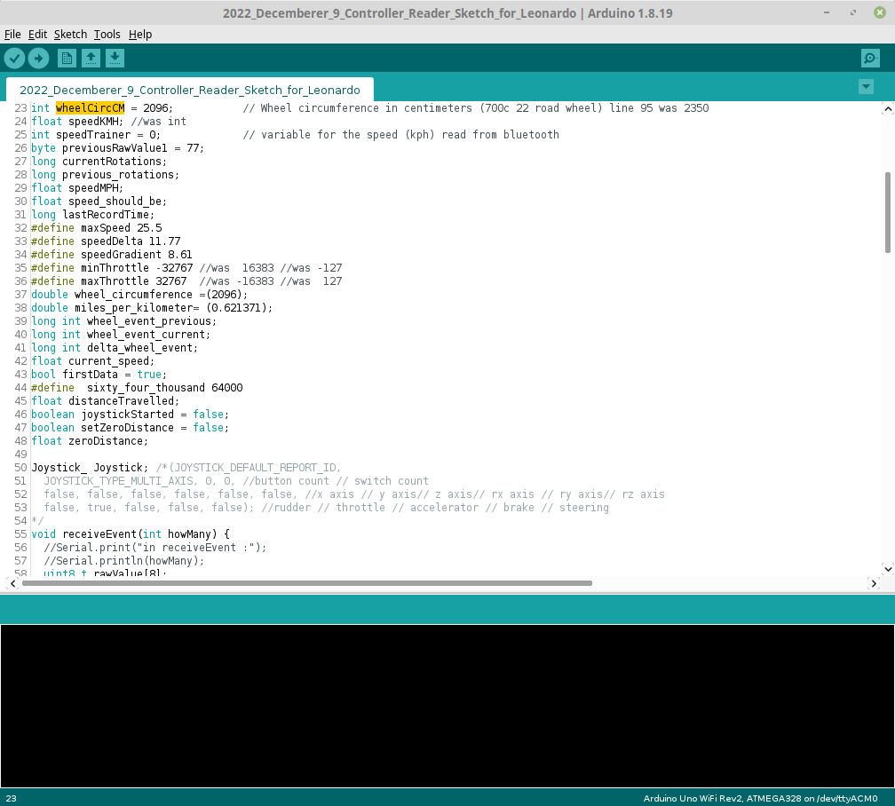
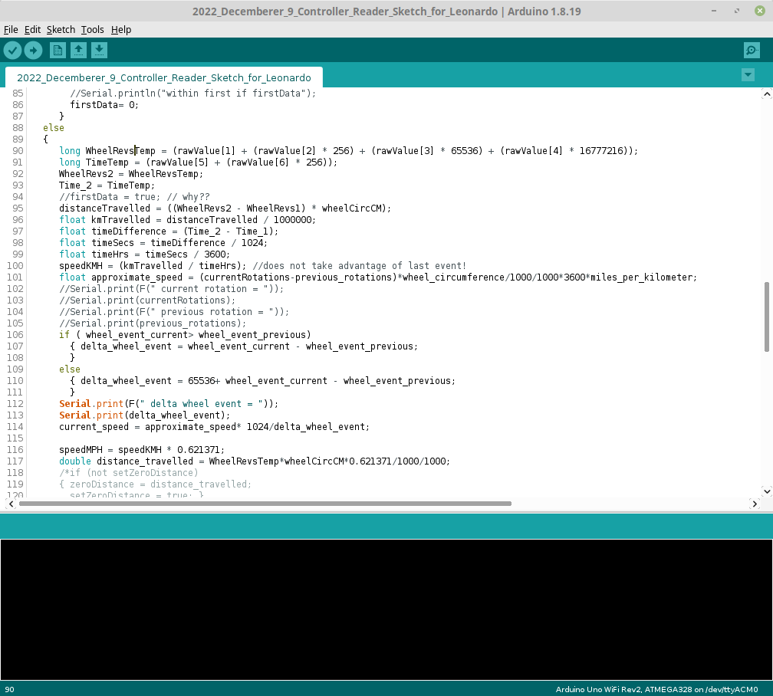
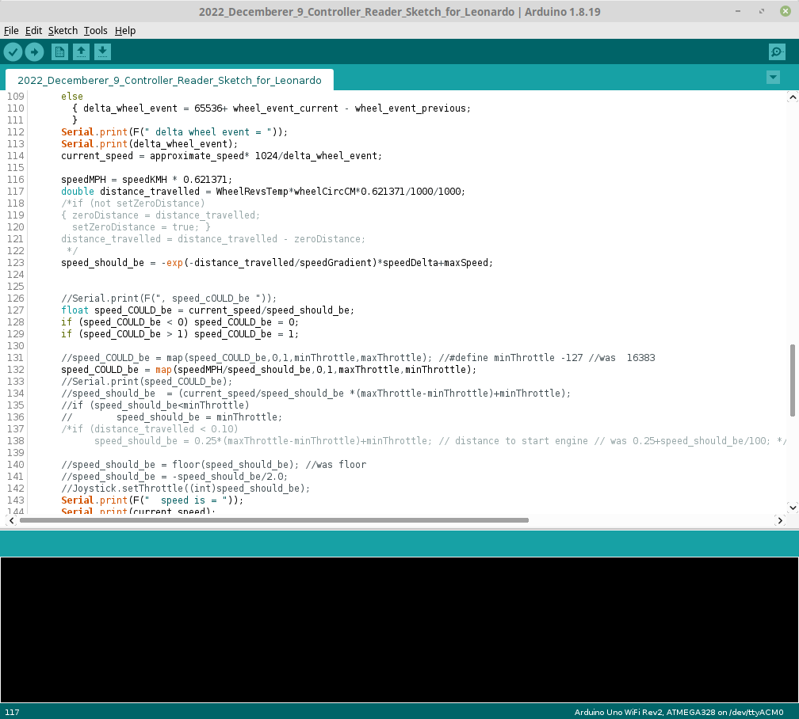
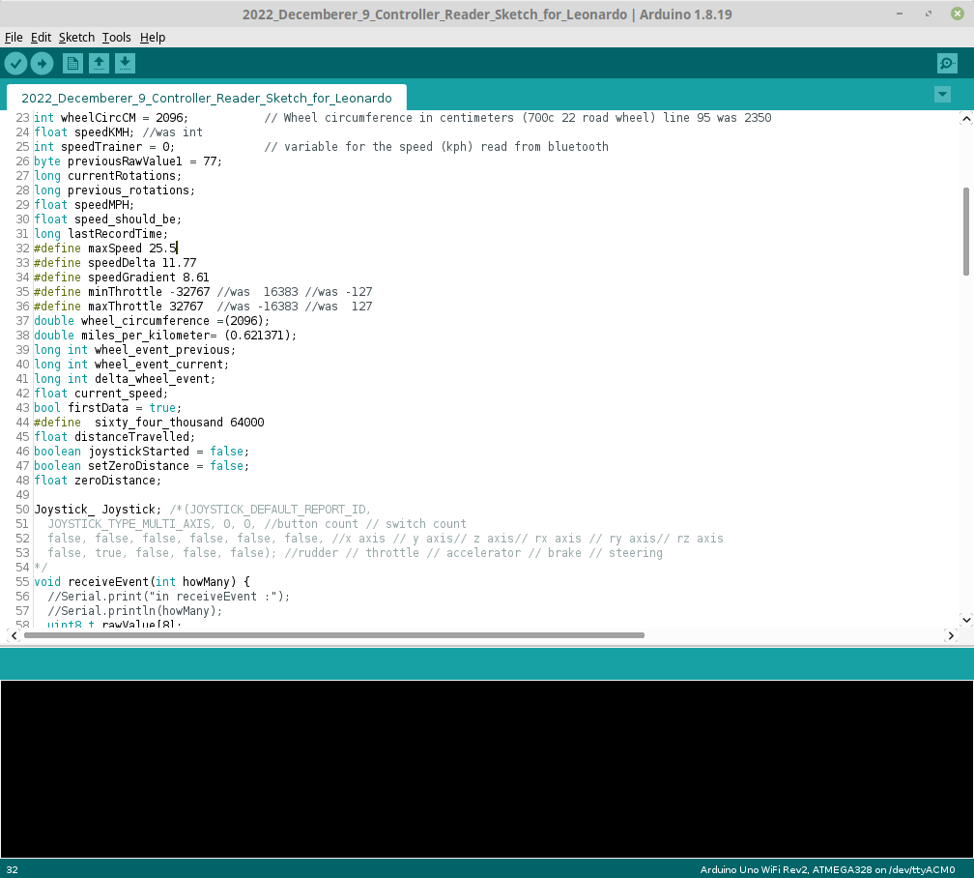

Details: Now, that speed is known, how is that translated into a throttle position.
Now, that speed is known, how is that translated into a throttle position. I think the throttle position should be related to the cyclists effort. But, the resistance of many trainers decrease as they are used to to heat rise. I believe the system can be thought a filling a tank with a hole at its bottom. As the water (the cyclists effort) pours into the tank, the water level increases. But, through the hole at the tanks bottom water also leaves. The rate of departure is related to the waters’ height (trainers’ temperature). Using a differential equation, formulas can be generated that relate the cyclist speed to how how far the cyclist has virtually travelled on the trainer.
miles/km m/km mm/m

